Slide 1

MACHINE LEARNING
Jeevana R Hegde –PES1201700633
Rishabh K Jain – PES1201700099

Slide 2

Problem statement and approaches
Use any Machine learning Algorithm for classification of a liver and non-liver set.
CONSTRAINTS
Coding must be from scratch.
Minimum accuracy needed: 90%.
Use Cross-validation (5-fold).
Comparison of performance between different models.
APPROCHES USED
Random forest using decision trees
Logistic regression
Naïve Bayes classifier
Case study on File System Checkers across Operating Systems. Learn about what makes a file system consistent and how exactly to check for it.

Slide 3

Pre processing: DATA CLEANING
The data set is initially split into two separate classes. The NULL values of each column belonging to one of the classes is then filled with the mean value of that column for that class.
The outliers from the class are removed using the z-value.
As the class with selector value 0 has fewer number of entries, bagging is used to make its size equal to the other class
The data is then normalized. Thus each column has values in the range 0 to 1.
This is stored in a separate csv file which is used to train and test the different models.

Slide 4
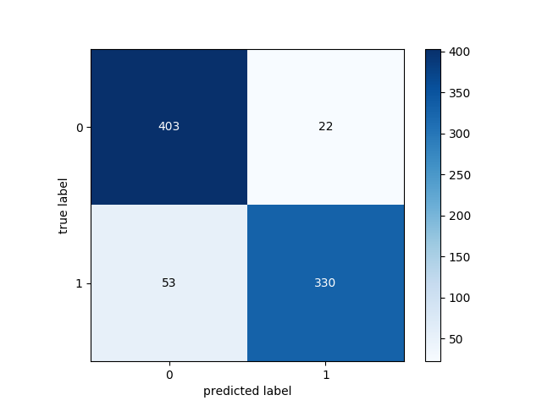
Random forest using decision trees
A random forest is a collection of decision trees whose results are used to vote on the final classification of the input.
3 training sets have been chosen with which 11 different decision trees have been created.
Each decision tree is trained on a separate subset of features, with the subset size restricted to 5 to prevent overfitting.
Final error: 0.0792
Train error: 0.0747
Test error: 0.0928
Execution time in seconds = 0:01:03.569129

Slide 5
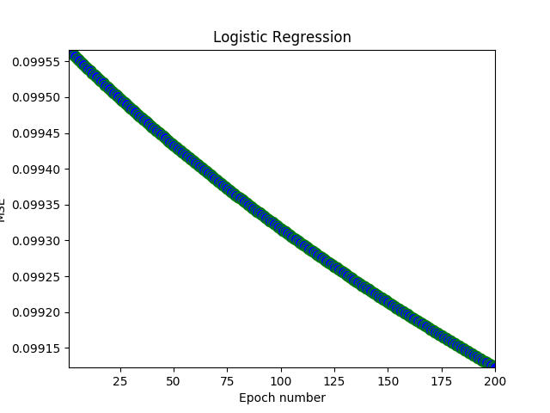
Logistic REGRESSION
Logistic Regression is a Machine Learning algorithm which is used for the classification problems. It is a predictive analysis algorithm based on the concept of probability.
It uses no hidden layers. A set of weights is created, one for each attribute and one for bias.
Each row of the training set is passed to the model and the logistic sigmoid function is applied on the continuous value that was obtained to transform the output to a probability value which can mapped to one of the two classes.
We have used 5 cross fold validation to train and test our model.
Statistics:
Training accuracy: 0.6903
Testing accuracy average of all folds: 0.6908
Final testing accuracy: 0.7339
Execution time in seconds- 0:01:37.729957

Slide 6
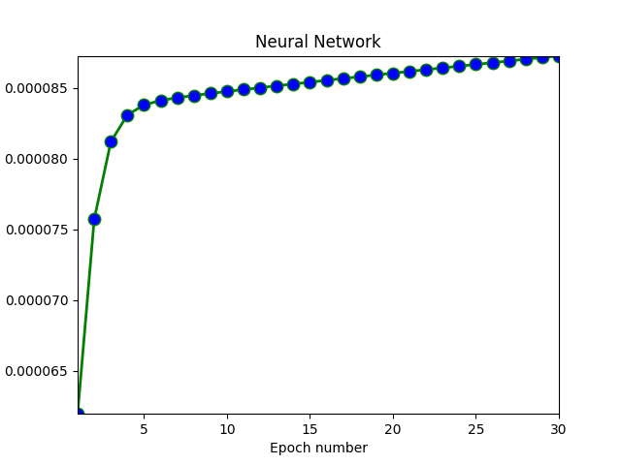
Naïve bayes classifier
Neural networks
classifier
A neural network is a type of machine learning which models itself after the human brain.
5 fold cross validation used.
Created using two hidden layers.
Used gradient descent for back propagation algorithm to update weights.
Naïve Bayes classifier is a classification technique based on Bayes’ Theorem with an assumption of independence among predictors.
5 fold cross validation has been used on our data.
The model predicts the probability of the given row belonging to the set by calculating the product of the probability of the class with the probabilities of each feature in the row for that class and returns the log of the product.
The class which predicts a higher probability for the row is the predicted class.
P(Class | X) = Log( P(Class) ) + Log( P(X1 | Class) + Log(P(X2 | Class)) + .... + Log(P(Xn | Class))
Statistics:
Average accuracy: 0.6961
Execution time in seconds = 0:00:00.242335
Statistics:
Training accuracy: 0.5700
Testing accuracy average of all folds: 0.5661
Final testing accuracy : 0.6064
Execution time in seconds = 0:02:15.491719

